Slide 1
Daily Review
Energy transfer: when energy moves from one object to another without changing form, we say it has been transferred.
Energy transformation: when one form of energy changes into another form, we say it has been transformed.
Classify the following as energy transfers or transformations. Give a reason for your choice.
Turning on a ceiling fan
Hitting a cricket ball with a bat
Ice-cream melting in the sun

Slide 2


Daily Review
Drawing Energy Flow Diagrams
Identify input (starting) energy form. Identify output (final) energy form/s. Are there any intermediate (in-between) energy forms? Draw a flow diagram: Use arrows to show energy transformation Use + if there are multiple energy forms
Draw an energy flow diagram for the energy transformation(s) in each of these situations:
Reminder
Kinetic Heat Light Sound Electrical Elastic Gravitational Chemical Nuclear
1. A fire burning
2. A person rock climbing
3. Playing with a wind up toy

Slide 3
Energy Conservation and Efficiency Year 8 Science

Slide 4

Learning Objectives
CFU
What are we going to learn?
Explain the law of conservation of energy and its implications
Identify waste energies and useful energies
Calculate energy efficiency of simple energy transformations
Activate Prior Knowledge
Energy is transformed when it changes from one form into another.
For example, a light bulb transforms electrical energy into light and heat energy.
Electrical energy → Heat energy + light energy
Of the two forms of energy that are produced, which one is more useful?
On your whiteboard, draw an energy flow diagram for a smartphone. Underline any forms of energy that are not useful.

Slide 5

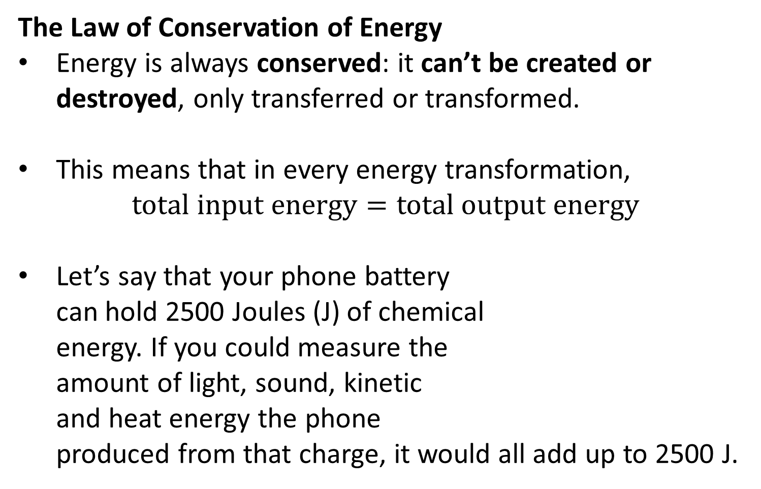
Concept Development
CFU 1
What does it mean for energy to be conserved?
The Law of Conservation of Energy
Energy is always conserved: it can’t be created or destroyed, only transferred or transformed.
This means that in every energy transformation,
$$\text{total} \text{input} \text{energy}=\text{total} \text{output} \text{energy}$$
Let’s say that your phone battery can hold 2500 Joules (J) of chemical energy. If you could measure the amount of light, sound, kinetic and heat energy the phone produced from that charge, it would all add up to 2500 J.
CFU 2
How would you express this in an equation?
CFU 3
What is the unit for energy?
Vocabulary
Joule (noun) the unit used to measure energy; J for short

Slide 6
Concept Development
CFU 1
Think, Pair, Share: what two things can an object do with input energy?
Energy Efficiency
Energy efficiency is a measurement of how good an object is at turning input energy into useful output energy.
Nothing is 100% efficient, so some input energy is always wasted, often as heat and/or sound.
Using the example of a light bulb:
CFU 2
In a TV, electrical energy is transformed into sound, light and heat. Which of these energies are useful?
CFU 3
What are the most common wasted energies?
Electrical energy → Light energy + heat energy
Input energy → useful output energy + wasted output energy

Slide 7
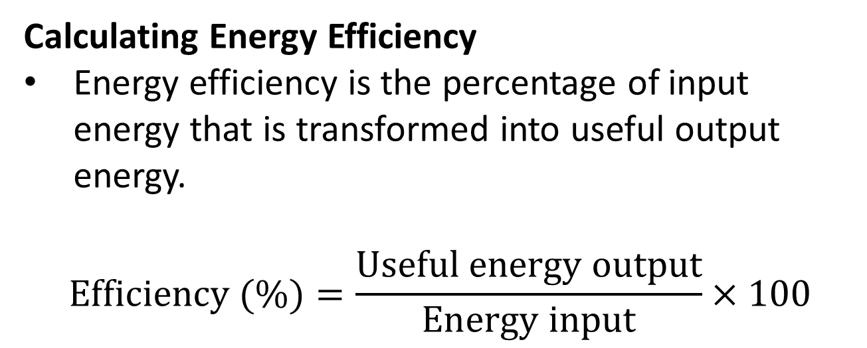
Concept Development
CFU 1
What is energy efficiency?
Calculating Energy Efficiency
Energy efficiency is the percentage of input energy that is transformed into useful output energy.
$$\text{Efficiency}\text{ (\%)}=\frac{\text{Useful} \text{energy} \text{output}}{\text{Energy} \text{input}}×100$$
CFU 2
How is energy efficiency calculated?
CFU 3
There are two types of output energy: Useful output energy Wasted output energy Which one is included in the energy efficiency calculation?
CFU 4
Energy efficiency is always written: In Joules (J) As a number with no units As a percentage In Joules per second (J/s)

Slide 8

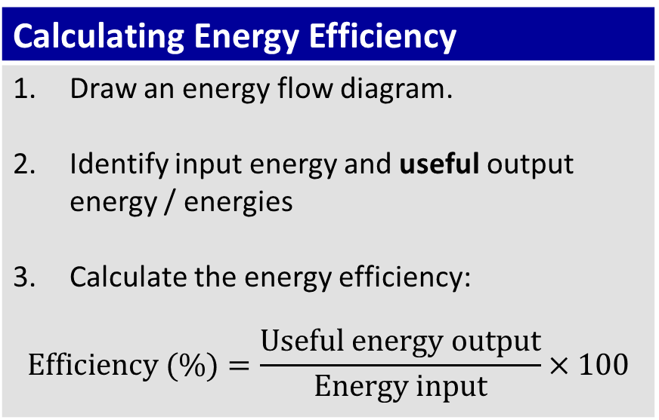
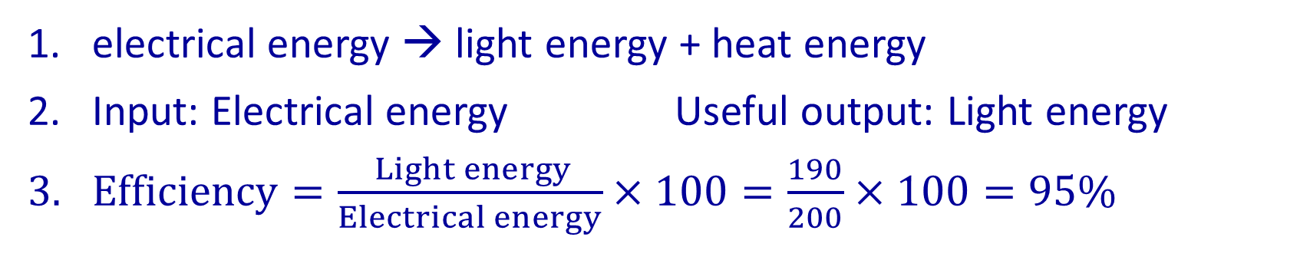
Skill Development / Guided Practice
Calculating Energy Efficiency
Draw an energy flow diagram. Identify input energy and useful output energy / energies Calculate the energy efficiency: $$\text{Efficiency}\text{ (\%)}=\frac{\text{Useful} \text{energy} \text{output}}{\text{Energy} \text{input}}×100$$
A lamp uses 200 J of electrical energy to produce 190 J of light energy and 10 J of heat energy.
electrical energy → light energy + heat energy
Input: Electrical energy Useful output: Light energy
$Efficiency=\frac{ Light energy}{Electrical energy}×100=\frac{190}{200}×100=95\%$

Slide 9

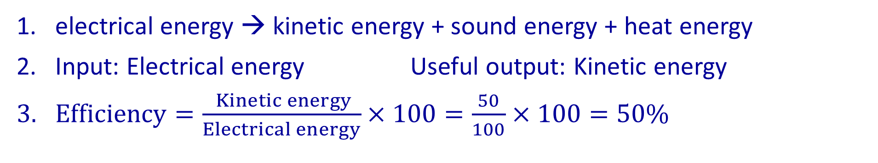
Skill Development / Guided Practice
Calculating Energy Efficiency
Draw an energy flow diagram. Identify input energy and useful output energy / energies Calculate the energy efficiency: $$\text{Efficiency}\text{ (\%)}=\frac{\text{Useful} \text{energy} \text{output}}{\text{Energy} \text{input}}×100$$
An electric mixer uses 100 J of electrical energy. It produces 50 J of kinetic energy, 25 J of sound and 25 J of heat.
electrical energy → kinetic energy + sound energy + heat energy
Input: Electrical energy Useful output: Kinetic energy
$Efficiency=\frac{ Kinetic energy}{Electrical energy}×100=\frac{50}{100}×100=50\%$

Slide 10


Skill Development / Guided Practice
Calculating Energy Efficiency
Draw an energy flow diagram. Identify input energy and useful output energy / energies Calculate the energy efficiency: $$\text{Efficiency}\text{ (\%)}=\frac{\text{Useful} \text{energy} \text{output}}{\text{Energy} \text{input}}×100$$
A chainsaw produces 200 J of kinetic energy, 200 J of sound energy and 100 J of heat energy from 500 J of electrical energy.
electrical energy → kinetic energy + sound energy + heat energy
Input: Electrical energy Useful output: Kinetic energy
$Efficiency=\frac{ Kinetic energy}{Electrical energy}x 100=\frac{200}{500}×100=40\%$

Slide 11

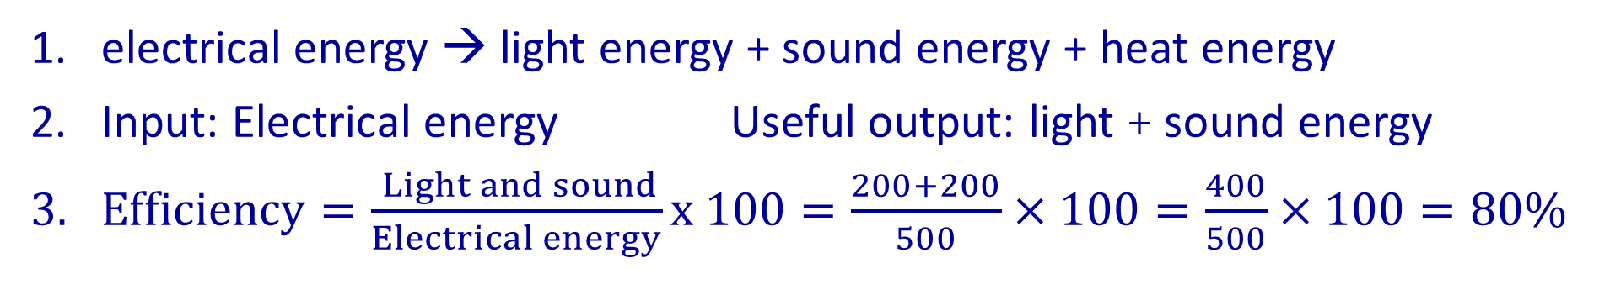
Skill Development / Guided Practice
Calculating Energy Efficiency
Draw an energy flow diagram. Identify input energy and useful output energy / energies Calculate the energy efficiency: $$\text{Efficiency}\text{ (\%)}=\frac{\text{Useful} \text{energy} \text{output}}{\text{Energy} \text{input}}×100$$
A TV produces 200 J of light energy, 200 J of sound energy and 100 J of heat energy from 500 J of electrical energy.
electrical energy → light energy + sound energy + heat energy
Input: Electrical energy Useful output: light + sound energy
$Efficiency=\frac{ Light and sound}{Electrical energy}x 100=\frac{200+200}{500}×100=\frac{400}{500}×100=80\%$

Slide 12
Skill Development / Guided Practice
Calculating Energy Efficiency
Draw an energy flow diagram. Identify input energy and useful output energy / energies Calculate the energy efficiency: $$\text{Efficiency}\text{ (\%)}=\frac{\text{Useful} \text{energy} \text{output}}{\text{Energy} \text{input}}×100$$
1000J of chemical energy in wood is released when it is burned. This transforms into 650 J of heat, 100 J of sound and 250 J of light.

Slide 13
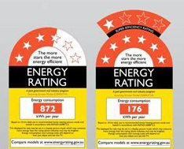
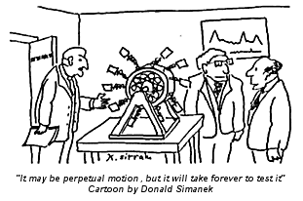
Relevance
Why do energy conservation and efficiency matter?
The Law of Conservation of Energy helps you to understand the energy transformations that you are constantly surrounded by.
Energy efficiency can save you money – energy efficient devices use less electricity for the same amount of useful work, and are therefore cheaper to run.
Inefficiencies in energy transformations show why perpetual motion is (unfortunately!) impossible.

Slide 14

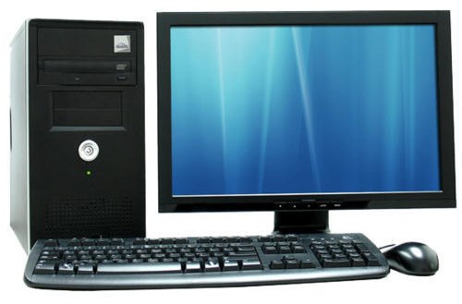
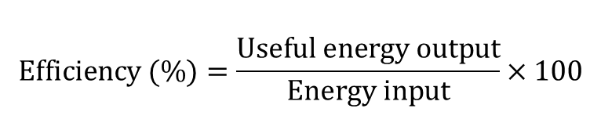
Skill Closure
$$\text{Efficiency}\text{ (\%)}=\frac{\text{Useful} \text{energy} \text{output}}{\text{Energy} \text{input}}×100$$
What is the Law of Conservation of Energy?
In the following flow diagrams, identify the input energy, useful output energy and wasted energy.
Electrical energy → Kinetic energy + Sound energy + Heat energy
Electrical → Kinetic + Sound + Heat + Light
Calculate the energy efficiency of a toaster which transforms 500 J of electrical energy into 450 J of heat energy and 50 J of light energy.

Slide 15
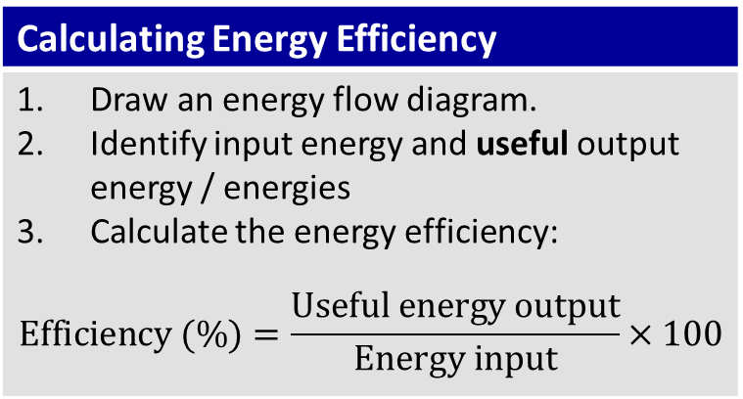
Independent Practice
For each object below, draw an energy flow diagram, identify input and useful output energy and calculate the energy efficiency of the object.
In a kettle, 400 J of electrical energy is transformed into 350 J of heat and 50 J of sound.
30 J of light and 20 J of heat are produced by a light bulb from 50 J of electrical energy.
A mobile phone uses 1000 J of chemical energy from a battery. This is transformed into 200 J of heat, 300 J of light, 300 J of sound and 200 J of kinetic energy.
Collect and complete the two energy efficiency worksheets.
Calculating Energy Efficiency
Draw an energy flow diagram. Identify input energy and useful output energy / energies Calculate the energy efficiency: $$\text{Efficiency}\text{ (\%)}=\frac{\text{Useful} \text{energy} \text{output}}{\text{Energy} \text{input}}×100$$

